Slide 1
Optimizing Human Resources in the Context of DSD: An interactive tool for HIV clinic and program managers
Differentiated Service Delivery 2018: Innovations, Best Practices & Lessons Learned
Dr. Samson Kironde
USAID HRH2030 Program
July 23, 2018

Slide 2
Optimizing Human Resources in the Context of DSD: An interactive tool for HIV clinic and program managers
Dr. Samson Kironde
USAID HRH2030 Program
Notes:
Emphasize that this presentation provides a only brief background to the tool and its development process. More details are found elsewhere in the documents that accompany the tool dissemination ( User Guide and Reference Guide).

Slide 3
Activity objective
Develop a simple, standardized, client-centered tool to assist facility-level and above-site managers to maximize the use of the health workforce to deliver differentiated ART services
Tool developed from data collected at 20 ‘experienced’ ART sites in Uganda; pilot testing was done at ten sites each in both Cameroon and Uganda
At ‘experienced’ ART sites, data collection was iterative and was done in three phases to incorporate learning
Notes:
Mention that the 20 ‘experienced’ sites in Uganda and the 10 pilot sites in both Uganda and Cameroon were selected using specific criteria agreed upon with key stakeholders.
Target audience:
Site-level ART clinic managers, Facility in-charges
Above-site HIV program managers e.g.,
National AIDS control program managers
District/County/Province/Region HIV program managers
Donors (USG/Global Fund/Foundations, etc.)
Implementing Partners/Principal Recipients/Civil Society
Others planning resources for ART service delivery

Slide 4
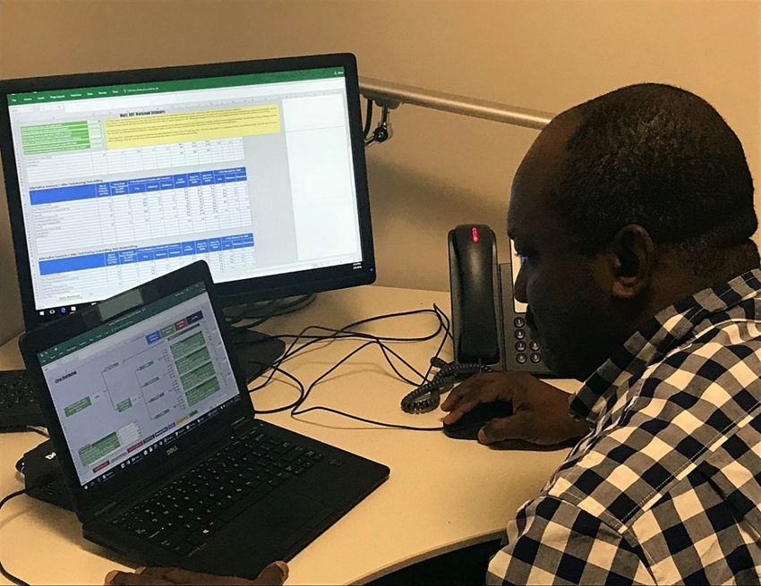
Tool functionality
Identify gaps/excess in current staffing
Apply task shifting/sharing for critical ART tasks
Redistribute ART clients to DSD models
Provide evidence for decision-making (e.g., staffing mix, capacity building needs and human resource requests)
Notes:
Emphasize that data for tool development was collected in several ways and triangulated in order to obtain a better understanding.
Client-service provider contact times are the main input used to drive algorithms in the tool. Benchmarks for these times were obtained from Uganda data.

Slide 5
Tool development
Key informant interviews (168); ART client interviews (329); focus group discussions (18); individual timesheet completion (130); ART client flow observations (395); and expert panel consultations (2 in-country meetings).
1,791 discrete critical tasks along the ART service delivery continuum were observed over ~64,000 minutes of observation time.
ART client ‘contact times’ with various types of service providers were used to model the benchmarks that drive the tool.
Lessons learned from pilot exercises and demos were used to improve the prototype version of the tool.
Notes:
Emphasize that data for tool development was collected in several ways and triangulated in order to obtain a better understanding.
Client-service provider contact times are the main input used to drive algorithms in the tool. Benchmarks for these times were obtained from Uganda data.

Slide 6
How does the tool work?
User-provided inputs
Tool outputs
Estimated # ART clients (stable/unstable, by sub-population group) to be served over next 12 months
# service providers (skilled and lay) by cadre type
Types of DSD offered
Human resource needs/gaps for DSD models implemented
Task shifting/sharing options to decrease gaps/optimize personnel
Visualization of DSD model/service provider arrays
Notes:
Mention that client sub-population groups include: adults, adolescents, children and pregnant and breastfeeding women
Emphasize that for facilities just starting out, types of DSD should be those they plan to offer at facility
Mention that data entry can be iterative until optimization of HRH/DSD models is achieved

Slide 7
What does the tool look like?
Users interact with several sheets

Slide 8
Provide required inputs into several sheets

Slide 9
Review the outputs and make adjustments as necessary

Slide 10
Target audience for the tool
Site-level ART clinic managers, facility team leaders
Above-site HIV program managers
National AIDS control program managers
District/county/province/region HIV program managers
Donors
Implementing partners/principal recipients/civil society
Others planning resources for ART service delivery
Notes:
Emphasize that tool has a site-level and above-site functionality

Slide 11
“This tool is going to help us a lot in task shifting. During the national DSD model training, they said we needed to carry out task shifting but we were not told how to do this....”
Staff at ART Clinic, Uganda

Slide 12
Limitations of the tool
Tool does not account for the time taken to conduct an HIV test and assumes that all clients entered into the tool have already been tested and are HIV positive
FTE estimates are only as good as the quality of data on ART critical task duration by service provider type
Tool is not predictive/cannot recommend the most optimum DSD models to use at the facility level
HIV services in other countries may be organized differently from those in Uganda on which the tool is based; users have to take this into account
No cost component is included for the various options of DSD models that can be implemented at a site

Slide 13
Acknowledgements
PEPFAR
USAID/Washington and Cameroon and Uganda Missions
CDC Cameroon
Ministry of Health, Uganda
Ministry of Public Health, Cameroon
DSD Technical Working Group, Uganda
Facility in-charges and staff at participating sites in Uganda and Cameroon
ART clients who were interviewed

Slide 14
Tool can be accessed at:
https://www.hrh2030program.org/tool_hrh-planning-for-hiv/

